Slide 1
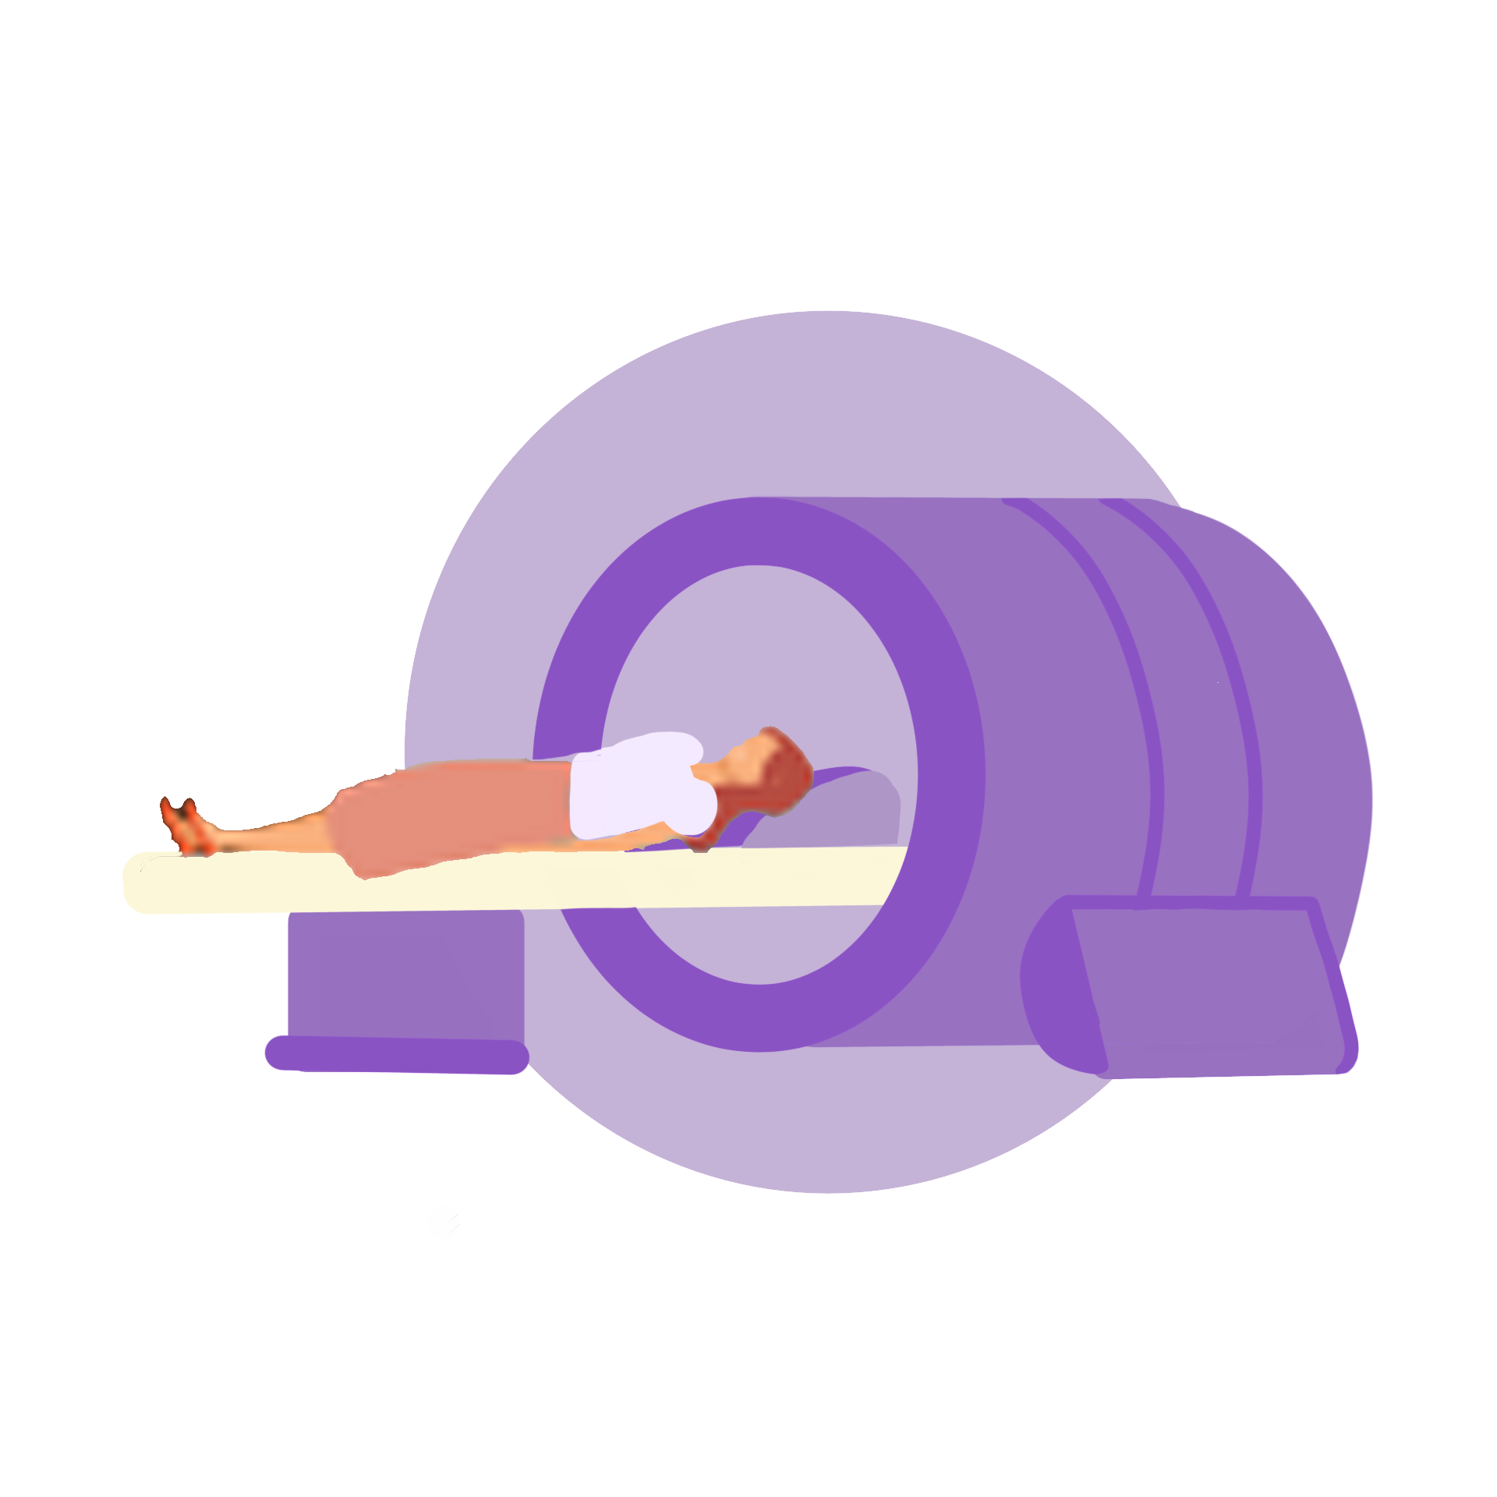

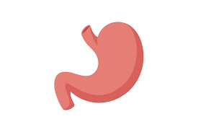
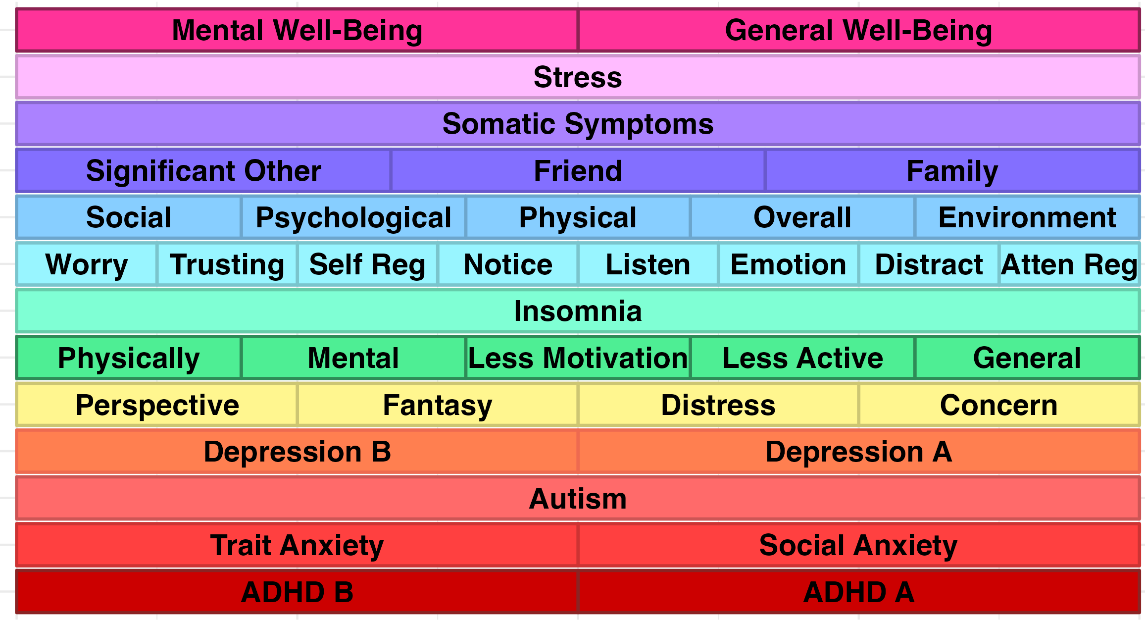
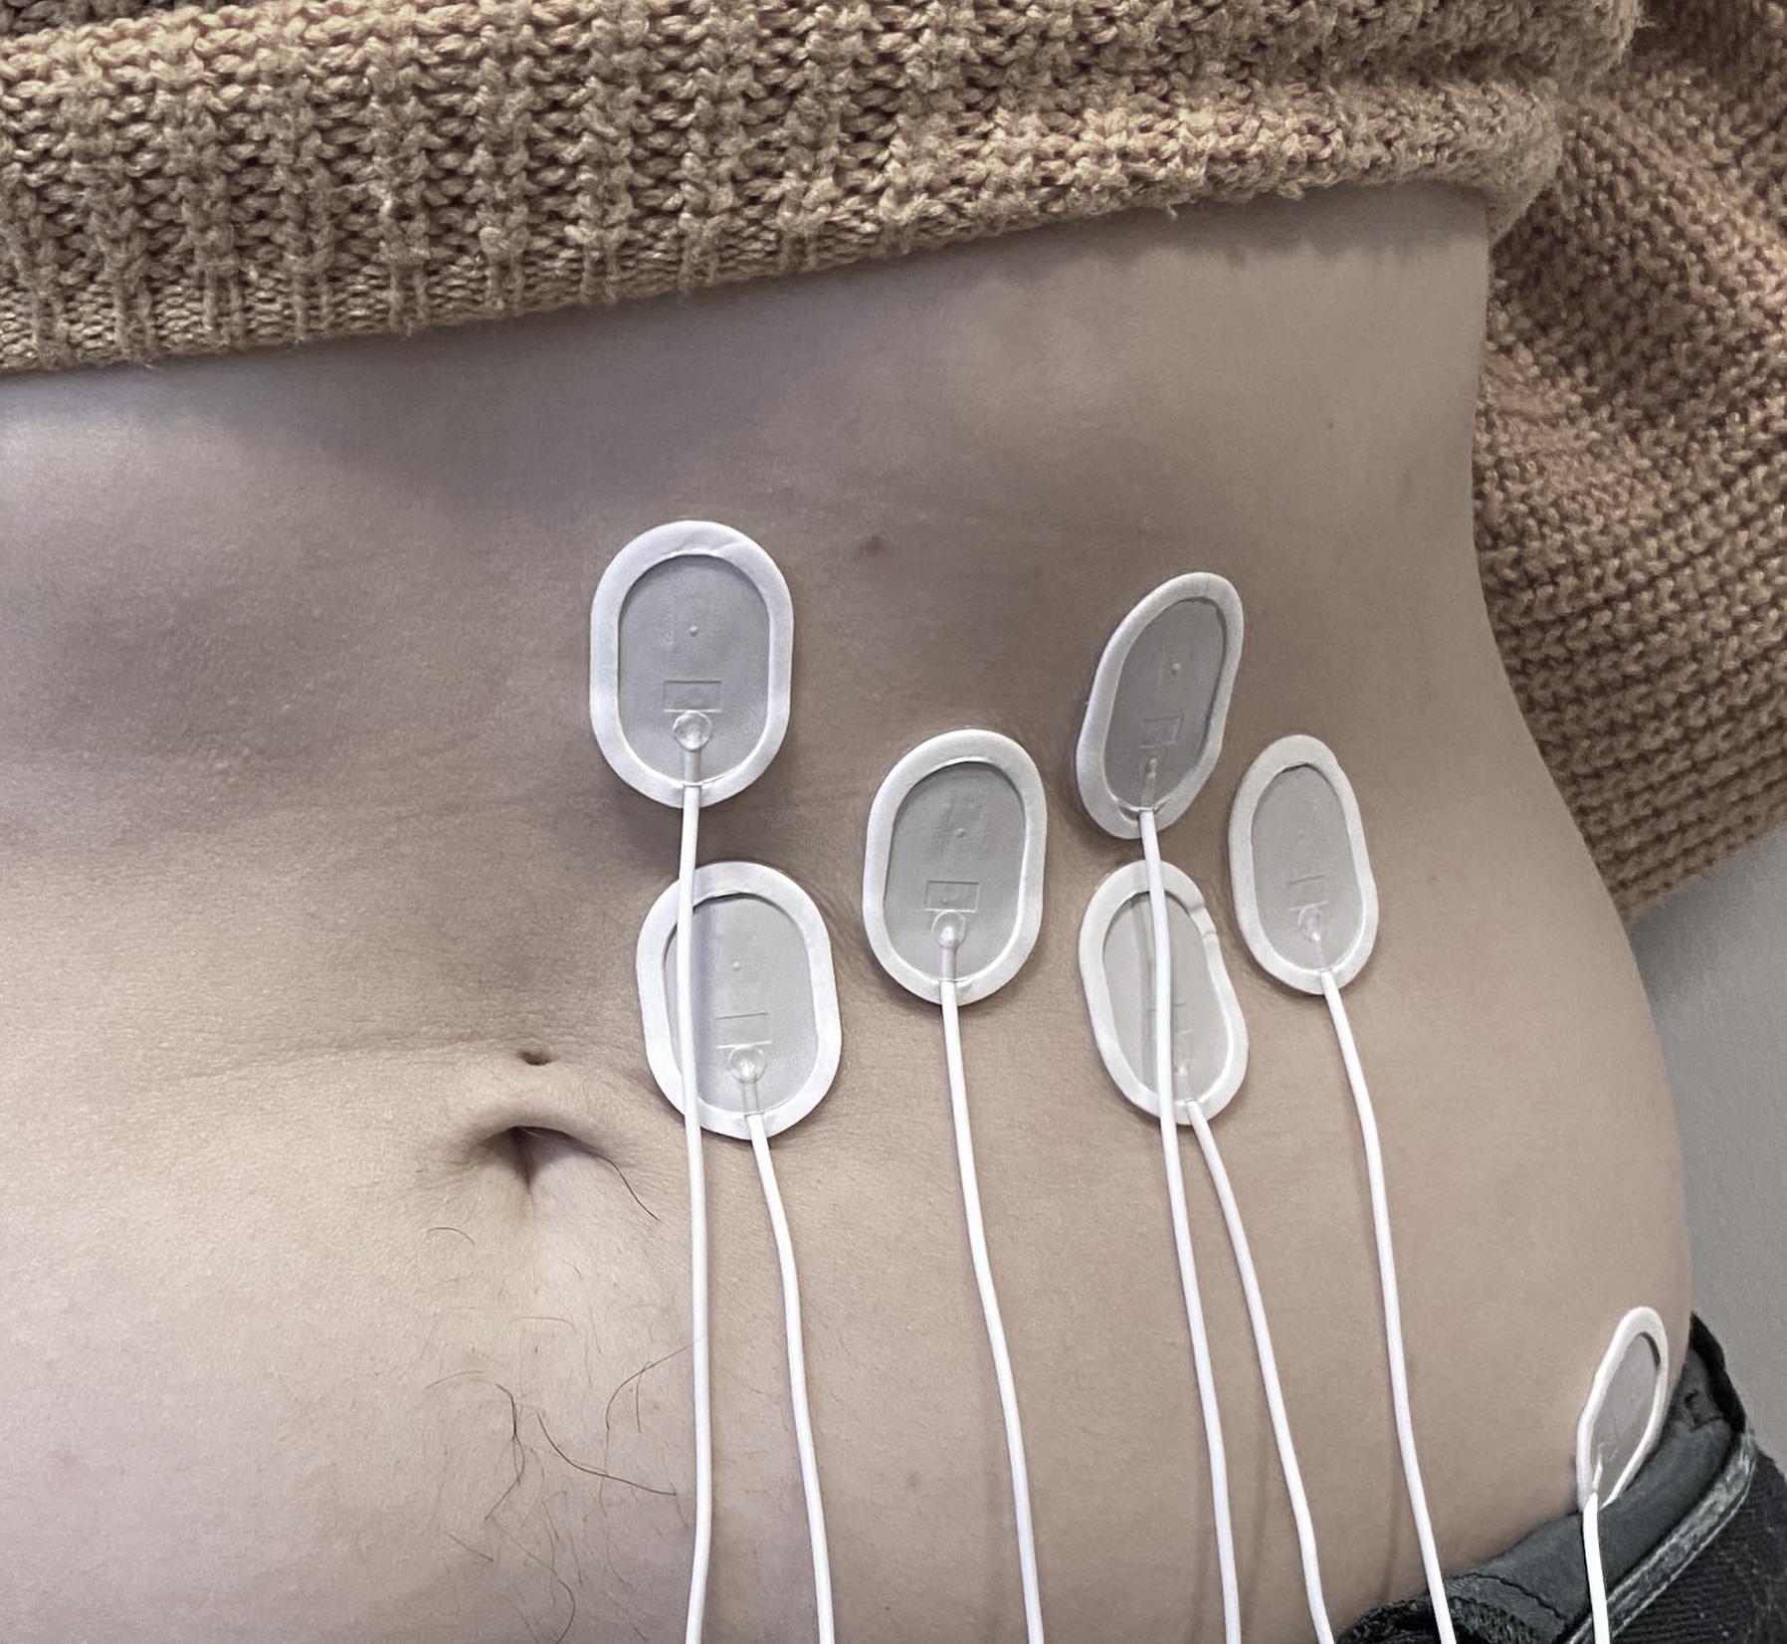
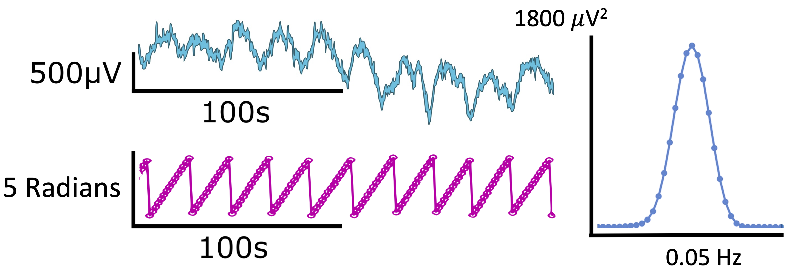
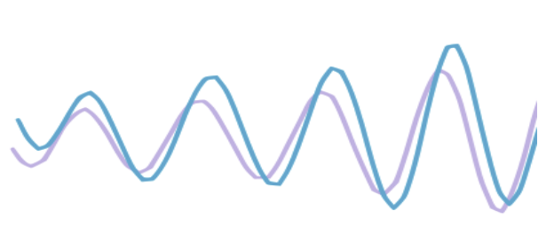
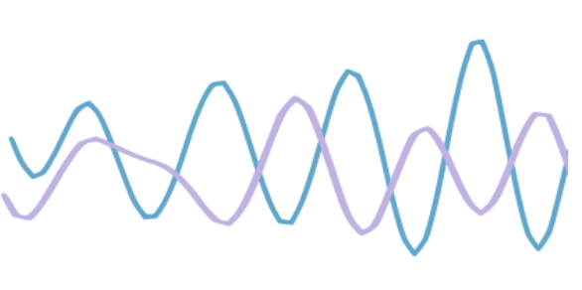
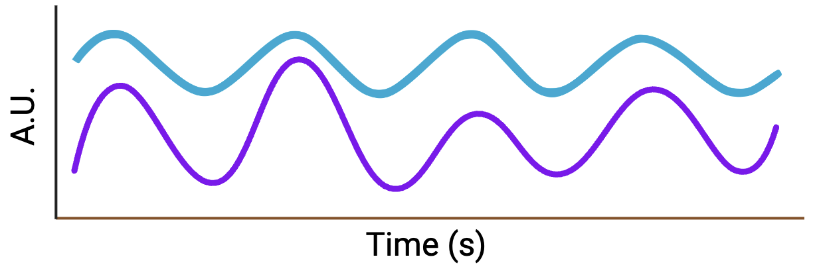

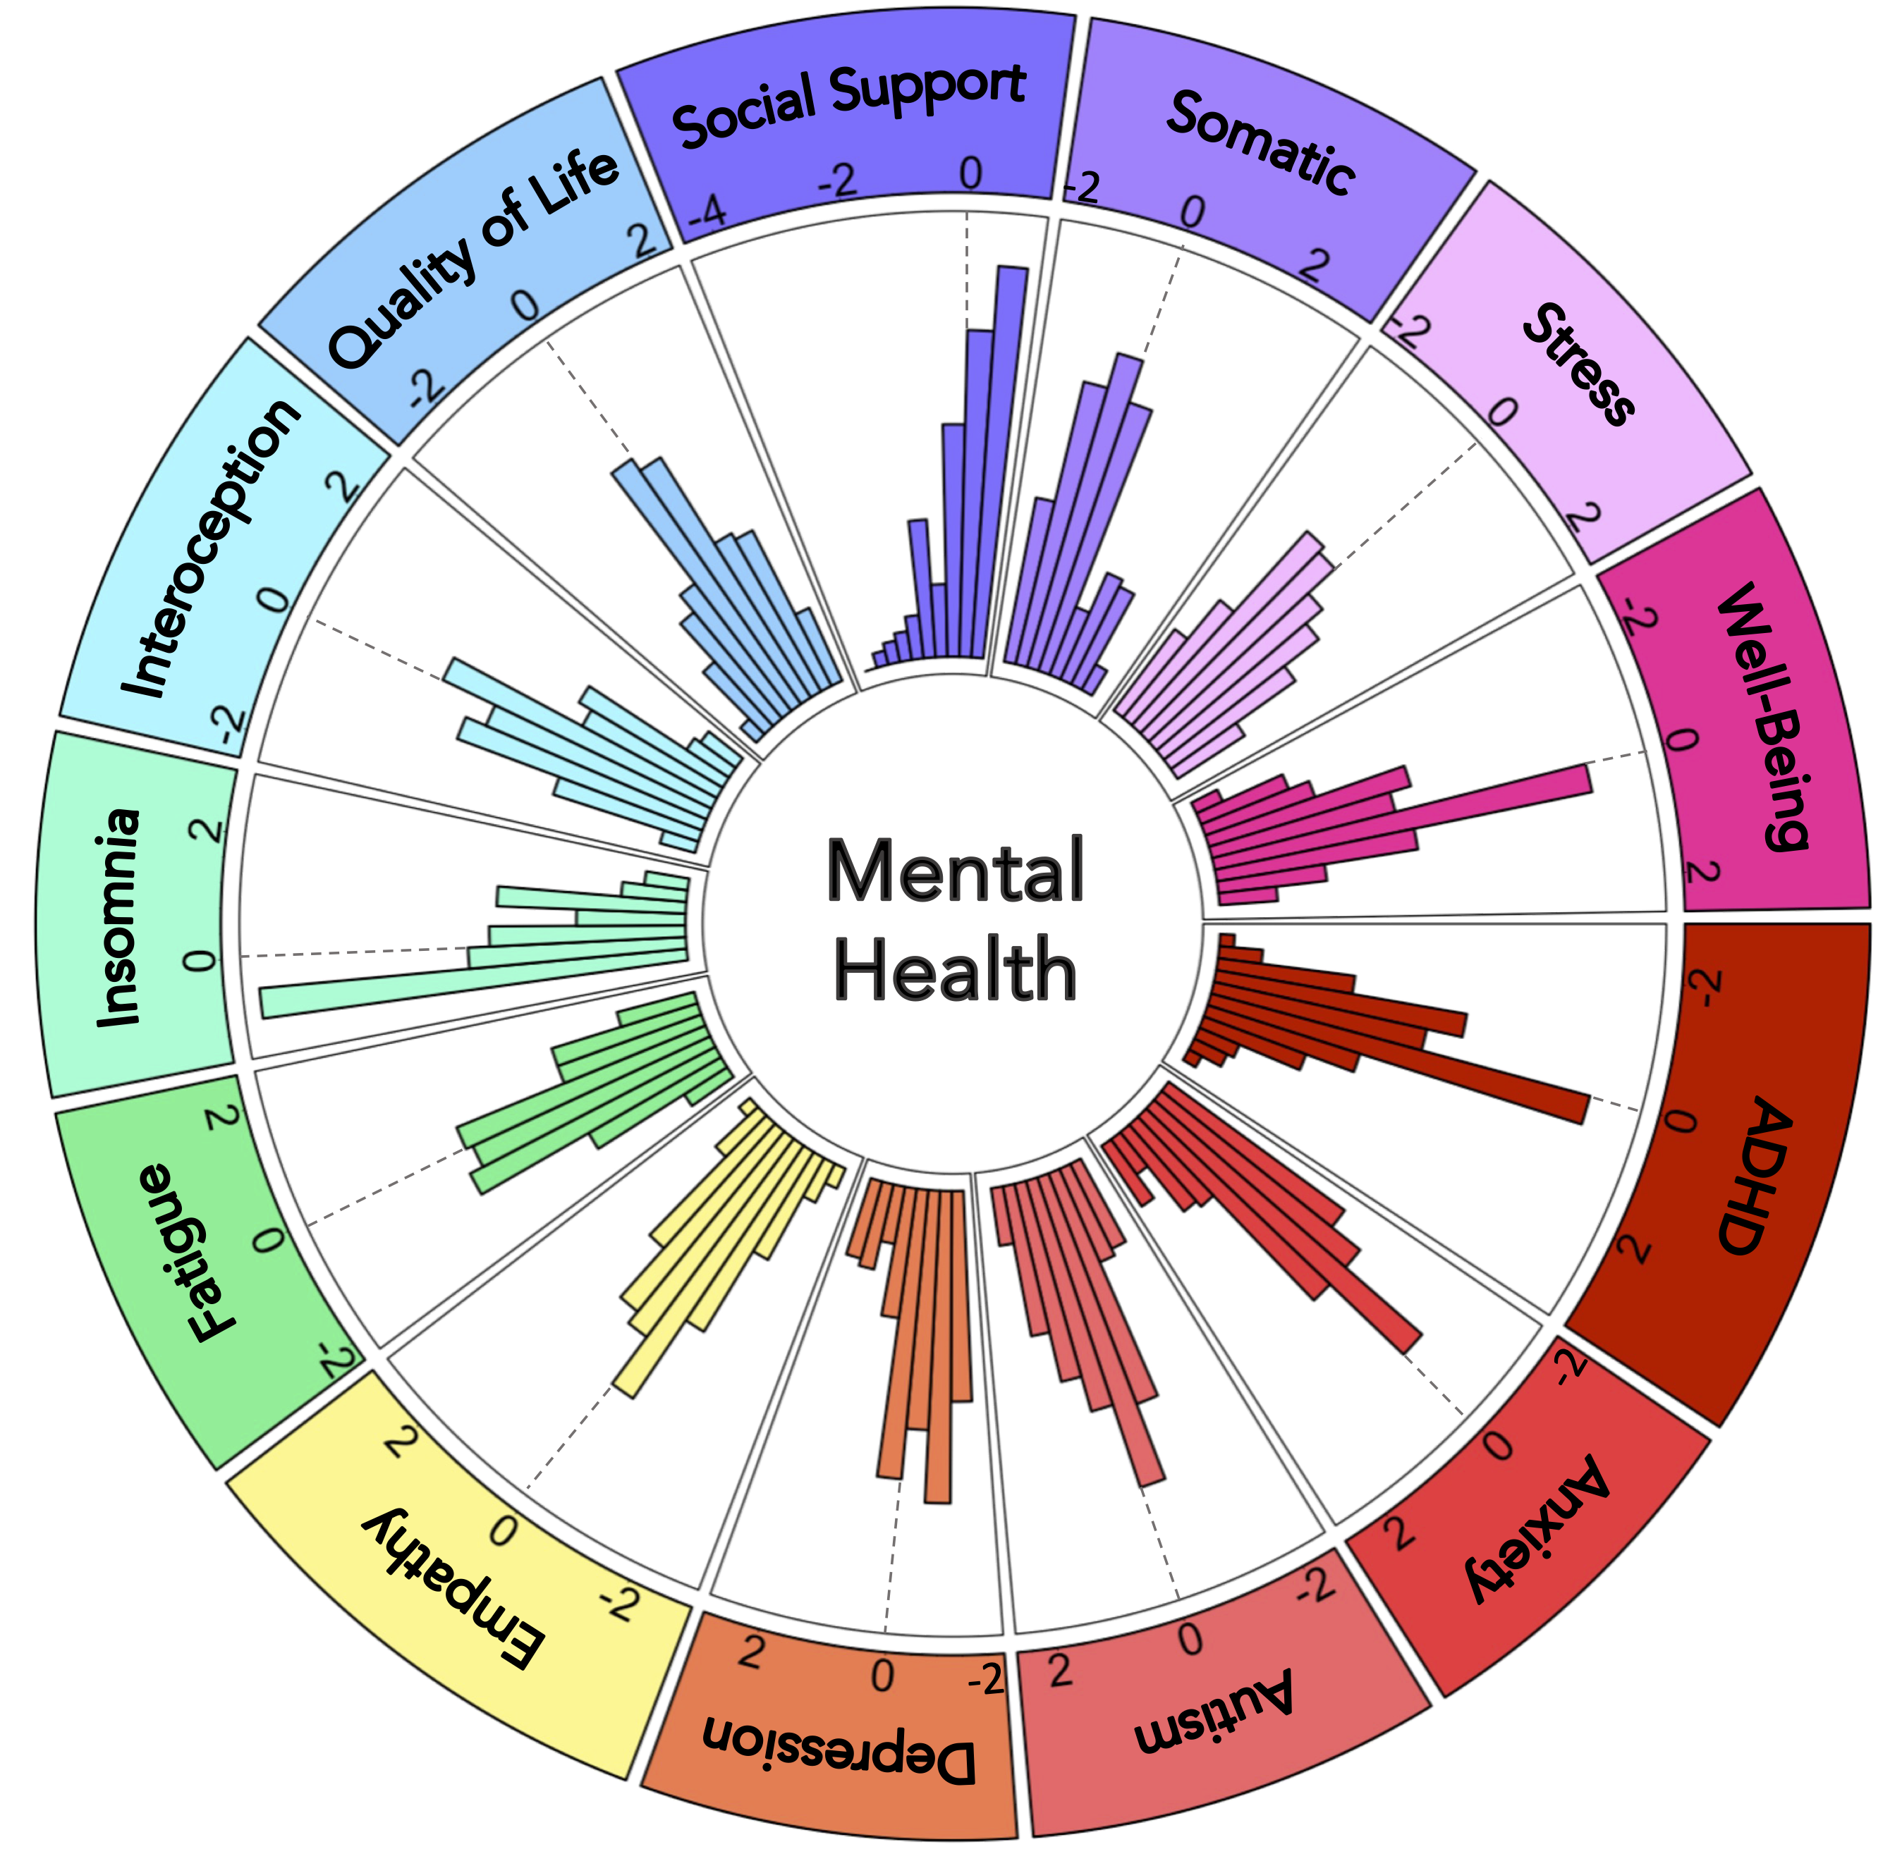


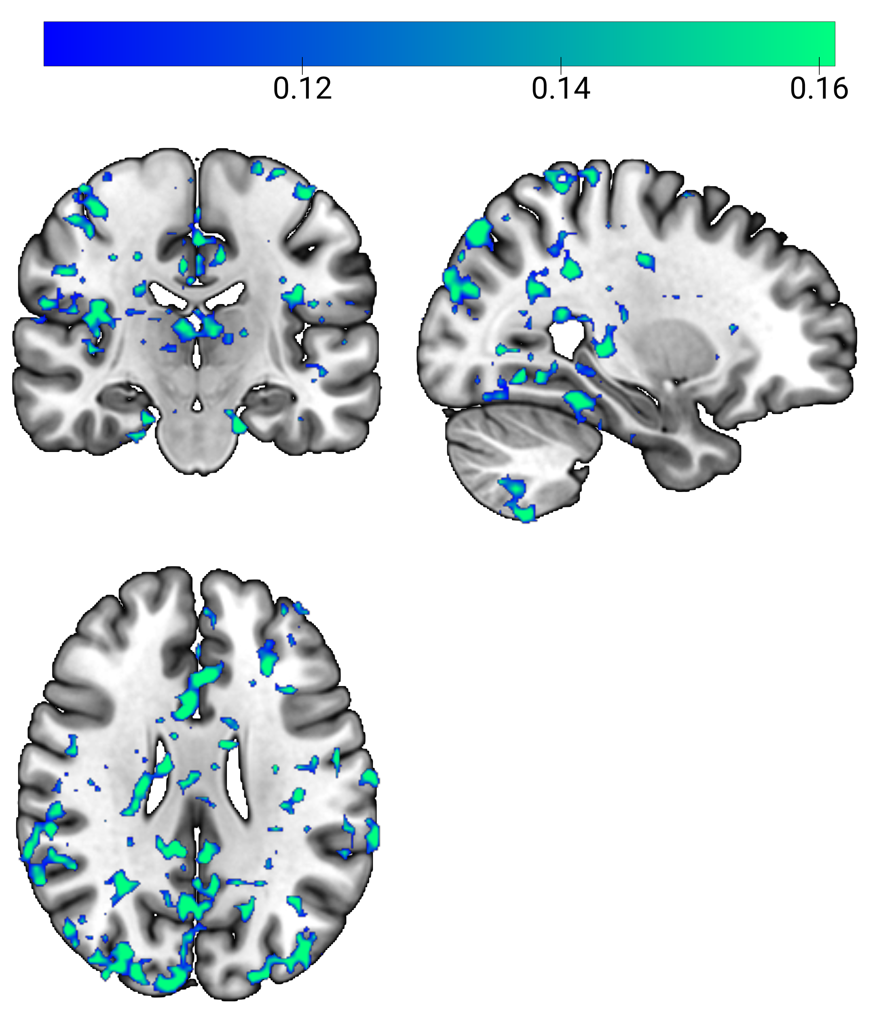
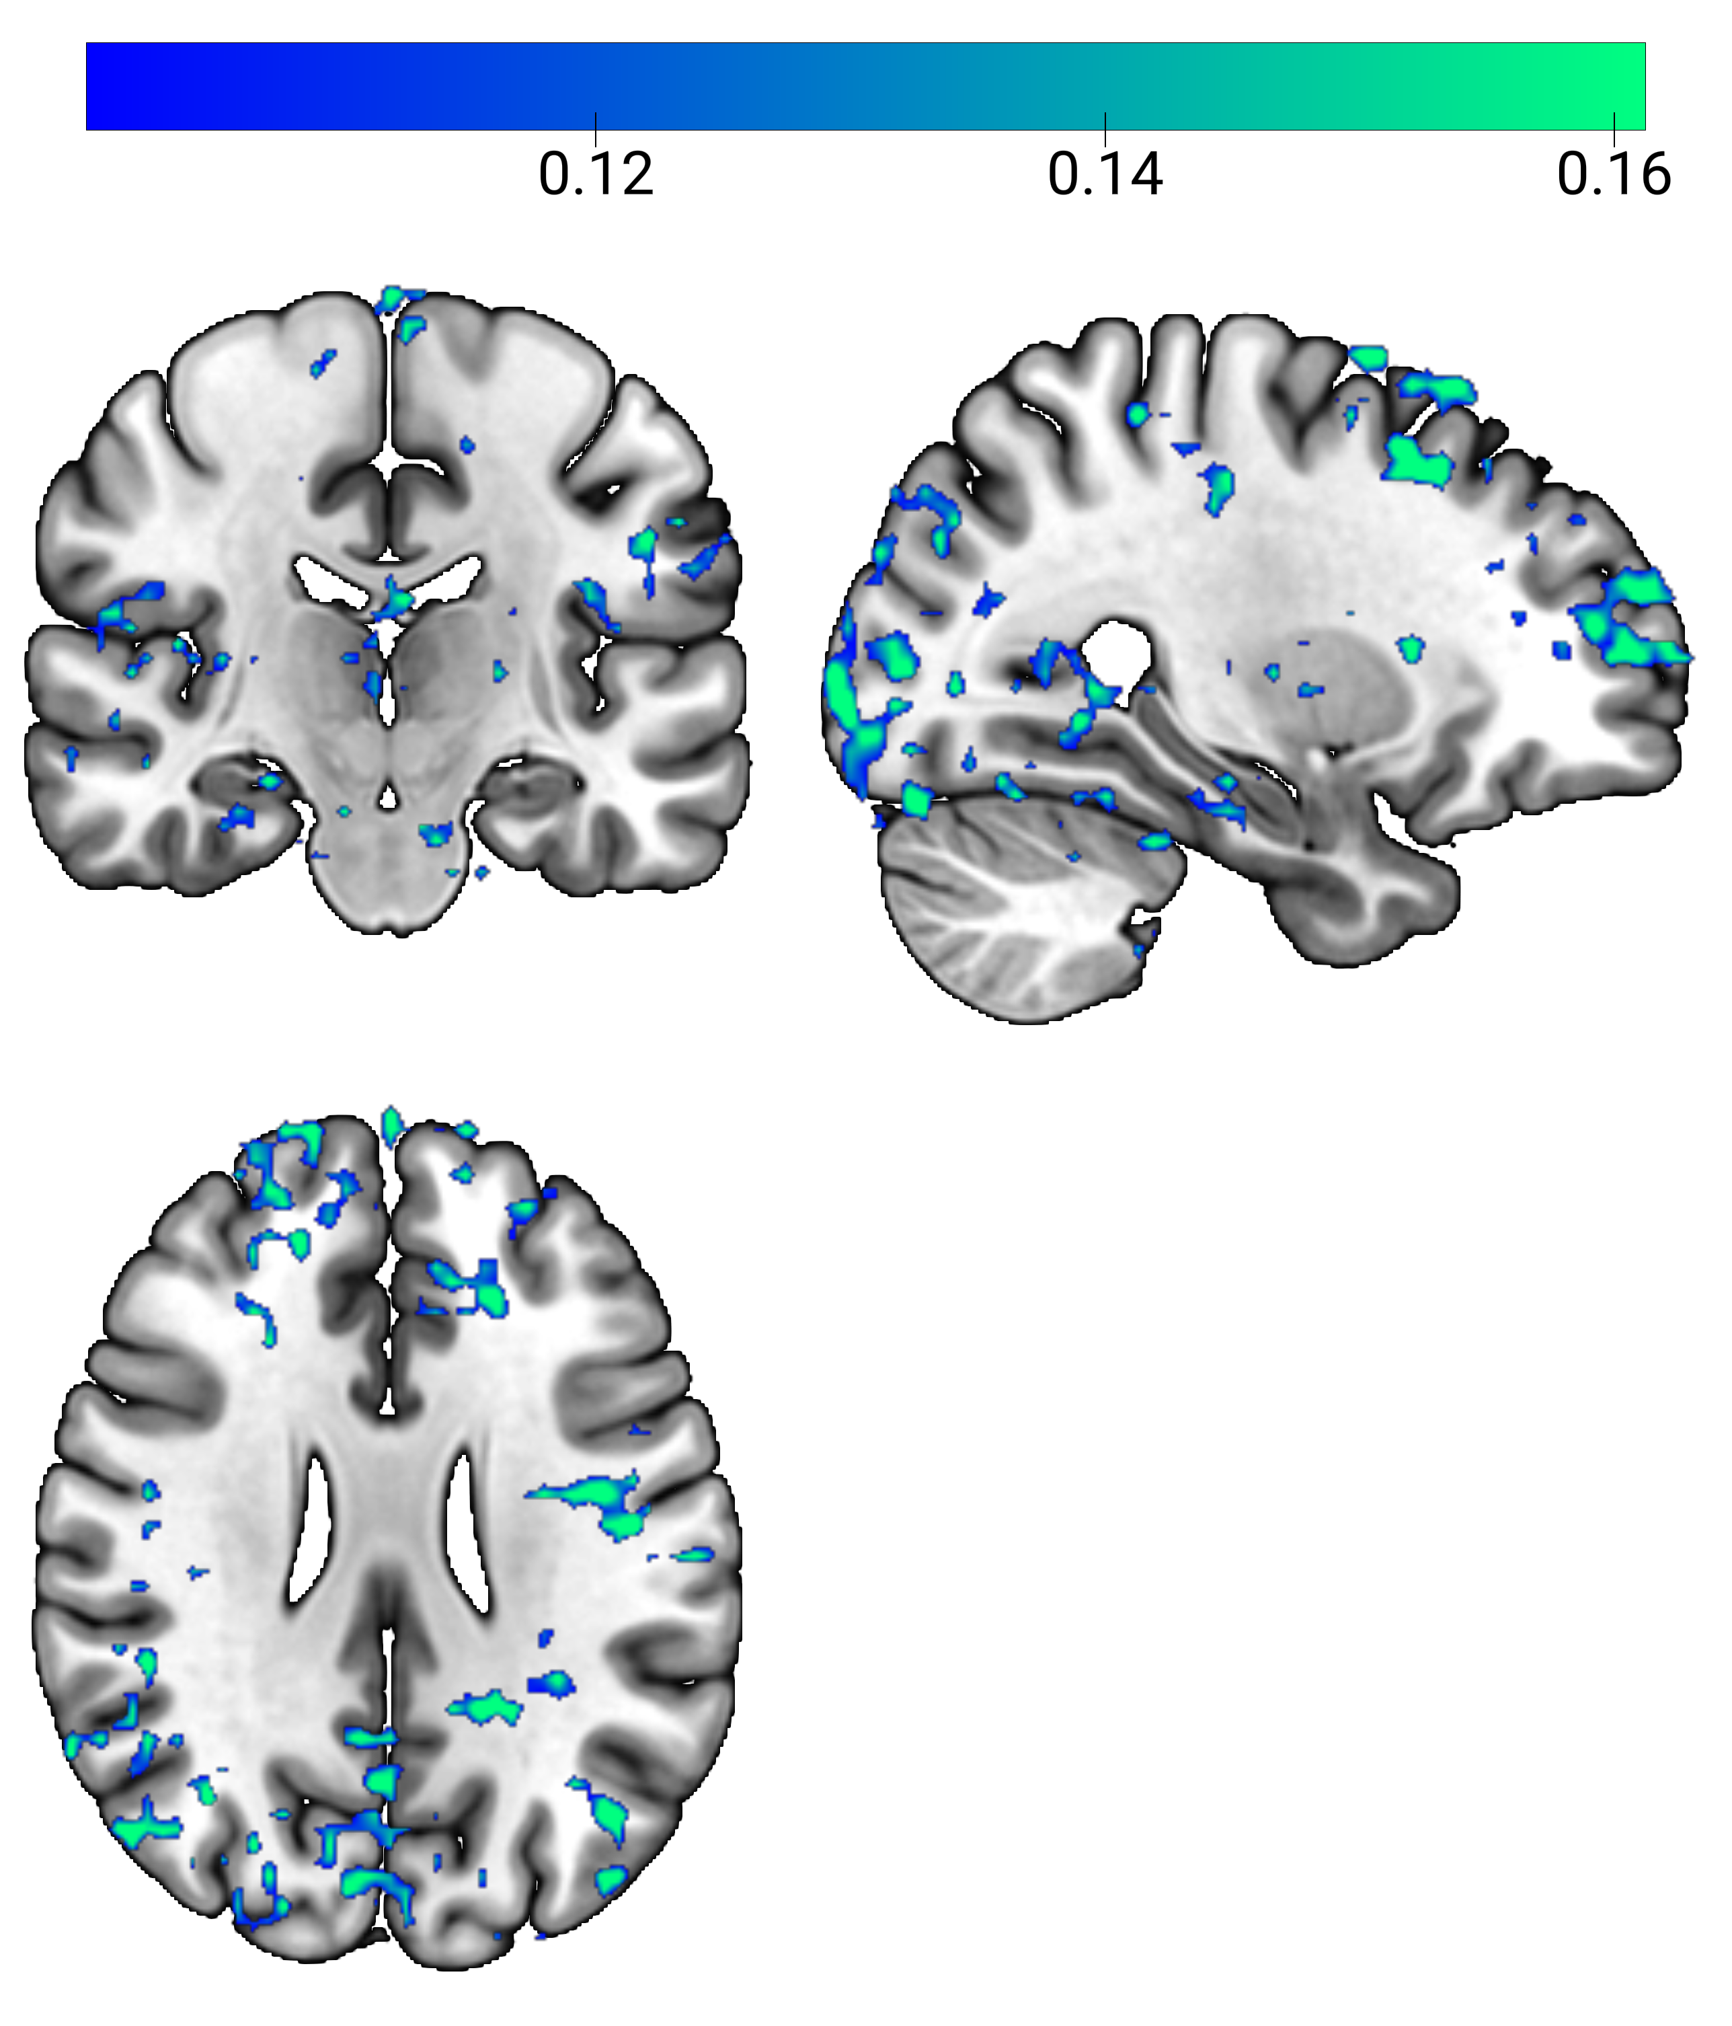
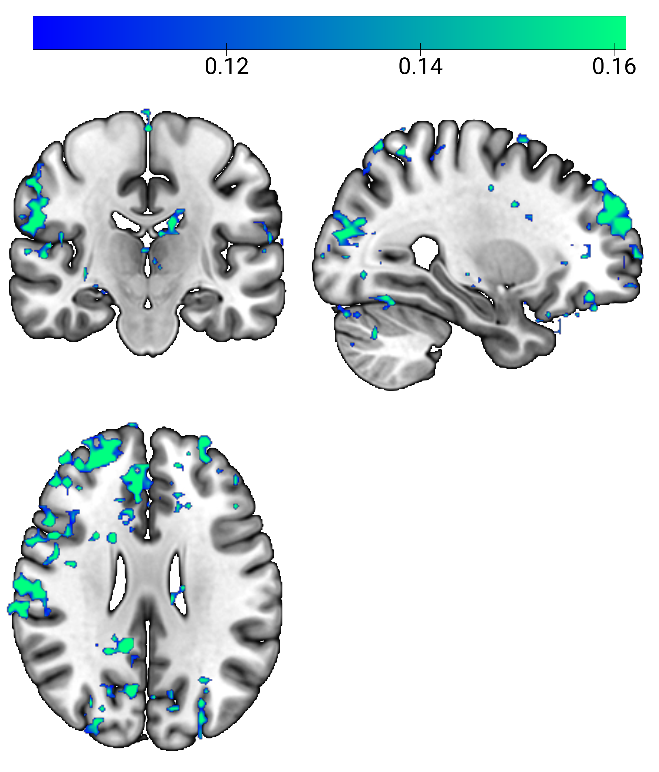
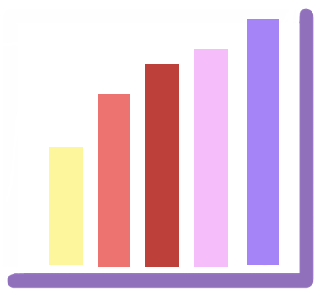
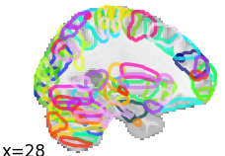
Mental Health and Lifestyle Inventory
Resting-State fMRI with ElectroGastroGraphy
Well-Being
Stress
Somatic
Social Support
Quality of Life
Interoception
Insomnia
Fatigue
Empathy
Depression
Autism
Anxiety
ADHD
Raw Gastric Cycles
37
Mental Health-
Lifestyle
Scores
Phase
Depression A
Depression B
0
Stomach-Brain Phase-Coupling
Power Spectra
ADHD A
ADHD B
CCA
Mental Health
Signature of
Stomach-Brain
Coupling
A.U.
Coupled
Uncoupled
Time (s)
Individual Coupling Strength
0.16
0.14
0.12
0.10
Mental
Health
Canonical
Variate
A.U.
Stomach-Brain
Canonical
Variate
Stomach-Brain
Phase-Coupling
per 209 Regions
*
Weights
*
Weights

